Slide 1



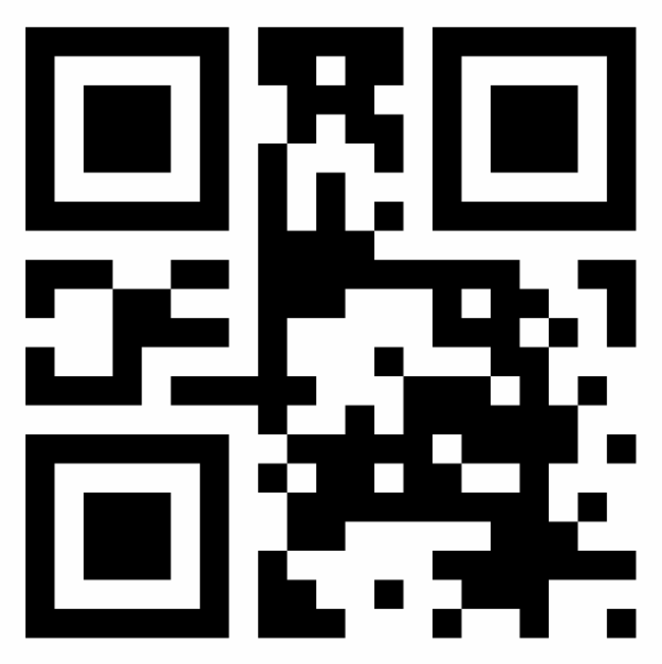










Closed circuits
A closed circuit is a physical area with multiple user-touchpoints connected with a high-speed local network (e.g., airports). In such spaces, users may use token kiosks to replace their 3P stickers (e.g., airline checked-in) with tokens (e.g., face, NFC passport, NFC bank cards, and phones with NFC payment). Check-points (e.g., gates, kiosks) verify sticker signatures for fraud, and verify the face hash for ownership. Users that opt-in for face recognition just walk pass.
1
Users start by providing a 3P sticker to the closed circuit at a self-service token kiosk. If the kiosk recognizes the sticker’s domain, then it verifies the authenticity of the sticker by validating its signature using the 3P’s public key.
The kiosk then verifies the ownership of the sticker by calculating the hash of the user’s face and comparing it with the face hash contained in the 3P sticker. If all is OK, then the 3P sticker is stored on an on-premises database, and events are raised.
Users can then opt-in to store their face biometrics so that the close circuit can automatically recognize them inside the perimeter with smart cameras.
Users can also register any NFC token to replace their sticker (e.g., e-passport, NFC bank cards, NFC-enabled smartphones).
When reaching a check-point (e.g., gates), users scan their stickers to be authorized. The check-point verifies the signature of the sticker and then scans the user’s face to calculate the face hash and compare it to the face hash in the sticker. It then reads the sticker’s codes and metadata to access if the user has the right grants.
Users with face biometrics registered are automatically recognized (e.g., just need to walk pass the gates). The check-point finds the registered face, then maps it to the stored 3P sticker already validated.
For users with NFC tokens registered, the check-point finds the stored sticker and only verifies the face hash.
2
Self-service token kiosk
Trust Graph
Closed circuit
check-point
3P sticker validations
export
sticker validation
S
verify 3P signature
get key
get key
verify 3P signature
sticker
3
1
5
S
trusted 3P public keys
3P sticker
verify
face hash
5
7
4
2
verify face hash
store
additional face check
face
verify codes & metadata
User
trust stamp
algorithm
3P stickers
5
User
Temporary
data
Other
tokens
opt-in for face recognition
find pass
by face
3
store
face biometrics
6
face
4
find pass by
NFC token
6
NFC tokens
store
NFC
tokens
NFC token
7
7

